Slide 1
Attitude
Double-click to enter subtitle

Slide 2
Video was not exported from SlideRocket
Silent BEATS

Slide 3
ATTITUDE
Double-click to enter text

Slide 4
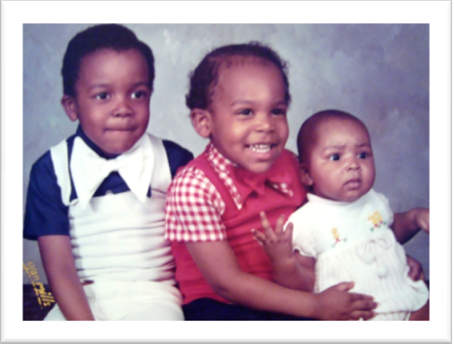
DOUBLE-CLICK TO ENTER TITLE
Double-click to enter text

Slide 5
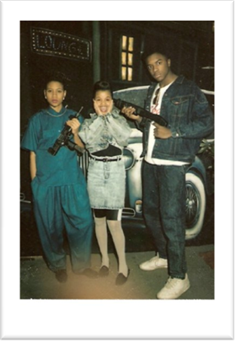
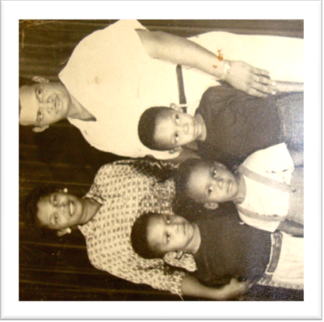
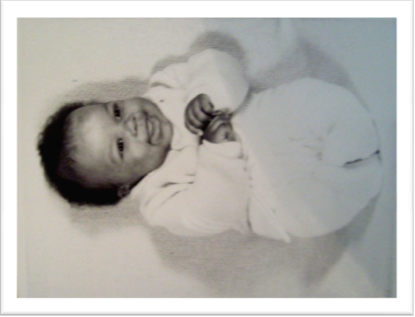
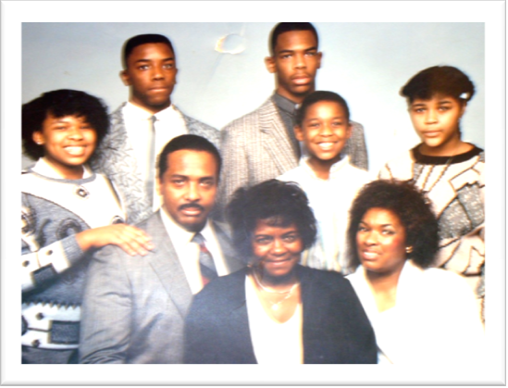
DOUBLE-CLICK TO ENTER TITLE
Double-click to enter text

Slide 6
Double-click to enter subtitle
GETTING WHAT WE WANT

Slide 7
WHAT DO YOU WANT?
It is important to note that we are all striving for the same things.
Our methods may not all be the same.
Acculturation, socialization and family values play a role in our development.

Slide 8
Safety
Rules
Guidelines
Boundaries
Predictability
“The Devil I know”
“Here's to the crazy ones, the misfits, the rebels, the troublemakers, the round pegs in the square holes... the ones who see things differently -- they're not fond of rules... You can quote them, disagree with them, glorify or vilify them, but the only thing you can't do is ignore them because they change things... they push the human race forward, and while some may see them as the crazy ones, we see genius, because the ones who are crazy enough to think that they can change the world, are the ones who do.”
- Steve Jobs
Safety

Slide 9
Significance
Purpose: Knowing
Value
Contribution
Goals
Self worth
CHOICE
“Your sole contribution to the sum of things is yourself.”
- Frank Crane
Significance

Slide 10
Belonging
Gangs
Family
Peers Groups
Teams
Social Groupings
Purpose in action
“The greatest thing in the world is to know how to belong to oneself.”
- Michel de Montaigne (1533 - 1592)
Belonging

Slide 11
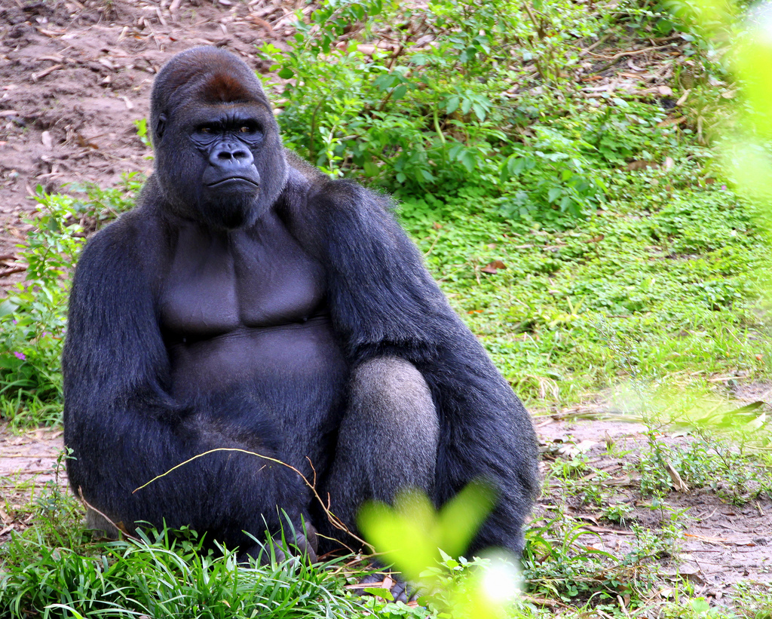
The trash, the game the winner
Great Apes don't go to the hospital
I hear what you say, I see what you do
LISTEN ONLY TO MOVEMENT

Slide 12
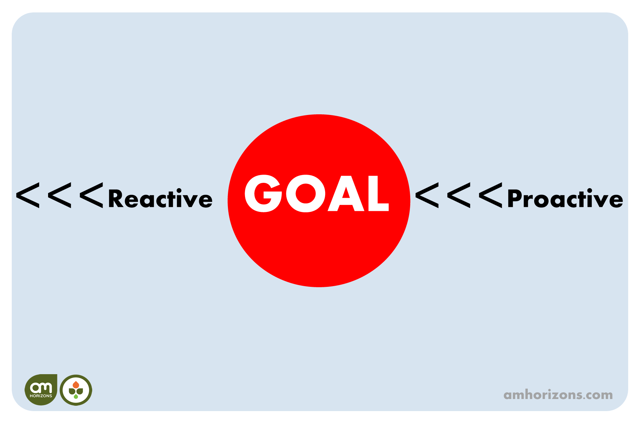
BAD/GOOD ATTITUDES
Double-click to enter text

Slide 13
HUMAN SOUL
Body
SPIRIT
13

Slide 14
Group was not exported from SlideRocket

Slide 15
Video was not exported from SlideRocket
CLARITY OF PURPOSE
Double-click to enter text

Slide 16
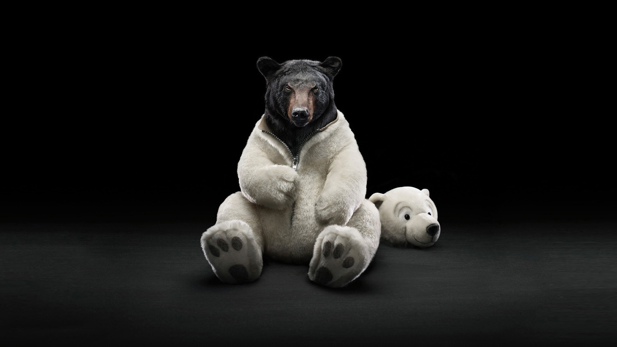
HUMILITY
SERVICE
LOVE
CODE SWITCHING
"KEEPING IT REAL"
CHECK YOUR ATTITUDE

Slide 17
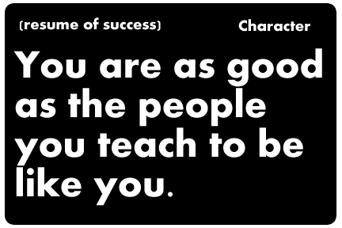
Video was not exported from SlideRocket
Mentoring:
3 PEOPLE TO HAVE
IN YOUR LIFE
Aspire
Admire
Aid

Slide 18
Video was not exported from SlideRocket
SERVICE
Everyone can be great...
Service is Creative
Empowering and Giving

Slide 19
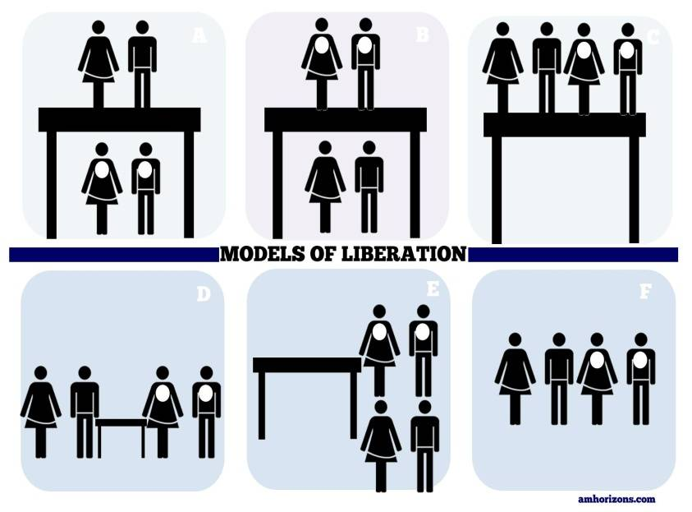
There is no conflict...
There is no conflict
The problem is the Problem...
We more alike...illusions
Methods differ...are negotiable
If it is like this, it could be different
Laws of Nature/ Laws of Man

Slide 20
DOUBLE-CLICK TO ENTER TITLE
Double-click to enter text

Slide 21
Video was not exported from SlideRocket
DOUBLE-CLICK TO ENTER TITLE

Slide 22
SMILE SHEET;
Please rate this session on:
Form2 was not exported from SlideRocket
Form2 was not exported from SlideRocket
Form2 was not exported from SlideRocket
Form2 was not exported from SlideRocket
Form2 was not exported from SlideRocket
Form2 was not exported from SlideRocket
Form2 was not exported from SlideRocket
Form2 was not exported from SlideRocket
Form2 was not exported from SlideRocket
Form2 was not exported from SlideRocket
Form2 was not exported from SlideRocket

